Slide 1

SOFTWARE TESTING
UE18CS400SB
Prof. Venkatesh Prasad
venkateshprasad@pes.edu
Department of Computer Science

Slide 2

SOFTWARE TESTING
Testing tools - Appium, Robotium, Selenium, Selendroid, UI Automator & Magneto
Venkatesh Prasad
Department of Computer Science and Engineering

Slide 3

Introduction to Appium
Appium is an open-source tool for automating native, mobile web, and hybrid applications on iOS mobile, Android mobile and Windows desktop platforms.
Native apps are those written using the iOS, Android or Windows SDKs.
Mobile web apps are web apps accessed using a mobile browser (Appium supports Safari on iOS and Chrome or the built-in 'Browser' app on Android).
Hybrid apps have a wrapper around a "webview" -- a native control that enables interaction with web content.
Importantly, Appium is "cross-platform": it allows you to write tests against multiple platforms (iOS, Android, Windows), using the same API.

Slide 4
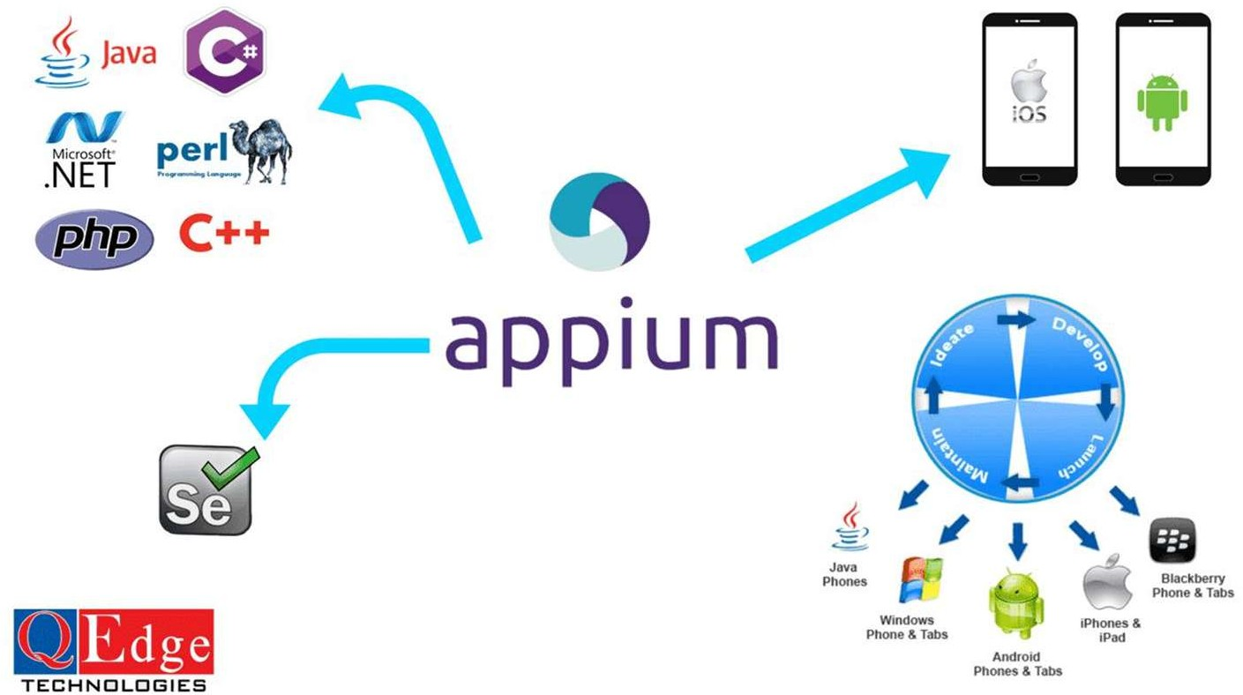
Introduction to Appium

Slide 5
Appium Philosophy
Appium was designed to meet mobile automation needs according to a philosophy outlined by the following four tenets:
Shouldn't have to recompile app or modify it in any way in order to automate it.
Shouldn't be locked into a specific language or framework to write and run your tests.
A mobile automation framework shouldn't reinvent the wheel when it comes to automation APIs.
A mobile automation framework should be open source, in spirit and practice as well as in name!

Slide 6
Concepts of Appium
Client/Server Architecture -
Appium is at its heart a web server that exposes a REST API.
It receives connections from a client, listens for commands, executes those commands on a mobile device and responds with an HTTP response representing the result of the command execution.
The fact that it has a client/server architecture opens up a lot of possibilities: we can write the test code in any language that has a http client API, but it is easier to use one of the Appium client libraries. We can put the server on a different machine than our tests are running on. We can write test code and rely on a cloud service to receive and interpret the commands.
Session - Automation is always performed in the context of a session. Clients initiate a session with a server in ways specific to each library, but they all end up sending a POST /session request to the server, with a JSON object called the 'desired capabilities' object. At this point the server will start up the automation session and respond with a session ID which is used for sending further commands.

Slide 7
Concepts of Appium
Desired Capabilities - Desired capabilities are a set of keys and values (i.e., a map or hash) sent to the Appium server to tell the server what kind of automation session we're interested in starting up. There are also various capabilities which can modify the behavior of the server during automation. For example, we might set the platformName capability to iOS to tell Appium that we want an iOS session, rather than an Android or Windows one. Or we might set the safari Allow Popups capability to true in order to ensure that, during a Safari automation session, we're allowed to use JavaScript to open up new windows.
Appium Server - Appium is a server written in Node.js. The beta of Appium is available via NPM (Node Package Manager). It is the development version so it might have breaking changes.
Recall Javascript is a programming language that is used for writing scripts on the website. NodeJS is a cross-platform and opensource Javascript runtime environment that allows the javascript to be run on the server-side. Nodejs allows Javascript code to run outside the browser.

Slide 8
Concepts of Appium
Appium Clients - There are client libraries (in Java, Ruby, Python, PHP, JavaScript, and C#) which support Appium's extensions to the WebDriver protocol. When using Appium, you want to use these client libraries instead of your regular WebDriver client.
Appium Desktop - There is a GUI wrapper around the Appium server that can be downloaded for any platform. It comes bundled with everything required to run the Appium server, so you don't need to worry about Node. It also comes with an Inspector, which enables us to check out the hierarchy of your app. This can come in handy when writing tests.

Slide 9
Uniqueness of Appium
Most of the tools require an additional agent that needs to be compiled with most of the application code so that the tool can communicate with the native mobile app. This is not true for Appium.
Appium functions as a server and runs in the background.
Has the capability to synchronize with TestNG testing framework.
Appium targets to automate with any mobile app developed in various programming languages and different type of frameworks.
You can take control with full access to backend APIs and Databases from test code.

Slide 10
Advantages of Appium
Firstly it is language agnostic, coming with support for a wide range of popular languages. If your language of choice has a webdriver client, you are able to use Appium. This is down to the shared jsonWireProtocol. This is of great convenience as it allows test developers to pick up the tool quickly. Languages supported include,but are not limited to Java, C#, JavaScript, Python, and ruby.
It is very simple to pick up and get started with easily. Similarly to the previous point, Appium has a lot of similarities to Selenium webdriver.The benefit of this is that if the test developers are used to writing selenium webdriver web tests then Appium should be relatively simple to pick up and quite intuitive.
Appium enables testing of multiple platforms from the the same test code base.For those working in a centralised test team or a team that works across both iOS and Android, it can reduce the amount of boilerplate code required to work with the test infrastructure and emulators.

Slide 11
Disadvantages of Appium
In our experience, Appium tests run a lot slower than tests written in either XCUITests or Espresso.
For testing cross platform apps there will always be some degree of technical complexity involved with Appium.
Notes:
XCUITests – Xcode User Interface Testing Framework launched by Apple in 2015.
Espresso is a testing framework for Android to write reliable user interface tests.

Slide 12
Conclusions of Appium
Everybody knows how mobile devices and their applications are increasing. These mobile applications work on multiple platforms.
Appium is a very good tool for mobile automation. Lots of organizations prefer it for its simplicity, ease of use and robustness.
Appium is very useful as it supports cross-platform tests.
It is language agnostic, coming with support for a wide range of popular languages.
Appium Demo
https://www.youtube.com/watch?v=7APcLr-cBM8

Slide 13
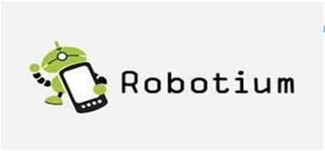
Introduction to Robotium
Robotium is the android test automation framework for testing native and hybrid android applications. Robotium can be used both for testing applications where the source code is available and applications where only the APK (Android Package) file is available and the implementation details are not known.
It provides simple API to write UI automation scripts. Using Robotium, the developer can create strong automatic GUI testing case for Android applications. In addition, the developer could write a functional, system and acceptance test scenario, spreading many Android activities. Robotium Test cases can be executed in Android emulator as well as the Android real device.
Although, Number of tools are available for testing Android applications, Robotium is the most commonly used Android testing tool

Slide 14
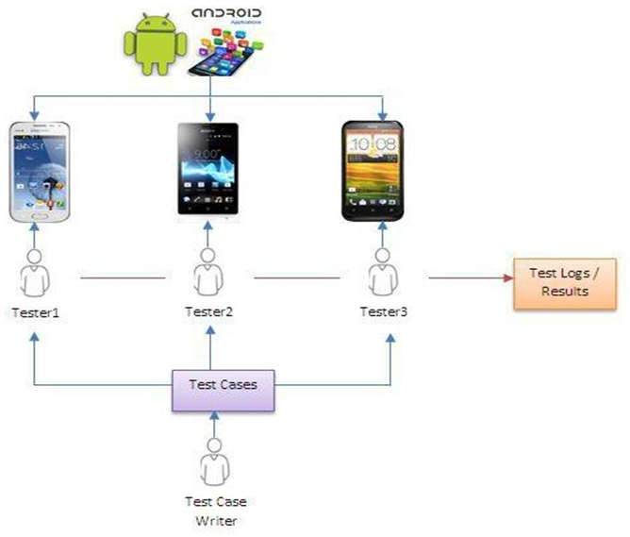
Salient Features of Robotium
Used to write black or white box tests (emphasis is on black box tests).
Robust and Powerful automation scripts covering user actions, assertions and verifications.
Support for Activities, Native elements, Web Views as well as Toasts (popups).
Based on Junit, opening the door for Unit Testing with Android.
Facilitates script execution with Real Devices as well as Emulators
Automatic detection of application activities.
Can be easily integrated with Build tools like Maven, Ant etc.
Test scripts can be developed with or without source code

Slide 15
Advantages of Robotium
You can develop powerful test cases, with minimal knowledge of the application under test.
The framework handles multiple Android activities automatically.
Minimal time needed to write solid test cases.
Readability of test cases is greatly improved, compared to standard
instrumentation tests.
Test cases are more robust due to the run-time binding to GUI components.
Integrates smoothly with Maven (open source software project management tool), Gradle (build automation tool) or Ant to run tests as part of continuous integration.
Available as Plugin in Android Studio & Eclipse.
Supports binary apks or application source code.
One scripts for Android versions.
https://www.jrebel.com/blog/java-build-tools-comparison

Slide 16
Disadvantages of Robotium
Test Execution on one device at a time.
Inability of handling different applications in one test
No possibility to test multi-process application.
No support for cross-platform (IOS, WIndows etc.) testing

Slide 17
Conclusions of Robotium
Robotium is the most commonly used Android Test automation tool.
Robotium Test cases can be executed on Android Emulator as well as the Real device, we don’t need to write any specific configuration code to run Robotium test cases on the Real device.
Robotium Can be easily written in maven project also, and it can be run through continuous integration tools.
Thus, Robotium is very useful in writing easy/simple Android Test automation scripts.

Slide 18
Distinction Between Robotium & Appium
Support for Mobile Platforms: Appium is a cross-platform test automation tool, whereas Robotium is a test automation framework for Android. Robotium supports different versions and subversions of the Google mobile operating system. So it can be used for testing a wide variety of Android apps. On the other hand, Appium supports iOS and Firefox OS along with Android. It allows testers to use of standard automation APIs on different platforms. The standard automation APIs do not require the mobile apps to be modified or recompiled during testing.
Type of Application: Robotium can be used for evaluating both native and hybrid mobile applications for Android. But Appium can be used to test mobile web apps along with the native and hybrid mobile applications. It can also be used by testers to control Chrome and Safari on mobile devices. So Appium can also be used to evaluate mobile websites across these web browsers.

Slide 19
Distinction Between Robotium & Appium
Option to Choose Programming Language: Robotium is designed to test software for a specific mobile platform. So it does not allow testers to write test cases by choosing from a set of programming languages. While using Robotium for Android application testing, the testers are required to write test cases only in Java. But Appium is designed with a WebDriver interface that supports several programming languages. Thus, Appium enables testers to write test cases in any of the WebDriver-compatible languages including Java, PHP, C#, Ruby, Python, Perl, Objective-C, Clojure, and JavaScript with Node.js.
Performance: Both Appium and Robotium lack Record and Play functionality. But Robotium requires testing professionals to work with the source code while automating tests. So testers have to invest additional time and efforts to write test cases for Robotium. Further, the Android application testing framework cannot effectively interact with system software, and does not provide screenshots. At the same time, the performance of Appium is impacted due to reduced XPath support on mobile devices. Also, many testing professionals feel the test reports generated by Appium to be poor and inadequate.

Slide 20

What is Selenium?
Selenium is a portable framework for testing web applications.
Selenium provides a playback tool for authoring functional tests without the need to learn a test scripting language.
Selenium is not just a single tool but a suite of software, each catering to different testing needs of an organization. It has four components.
Selenium Integrated Development Environment (IDE)
Selenium Remote Control (RC)
WebDriver
Selenium Grid

Slide 21
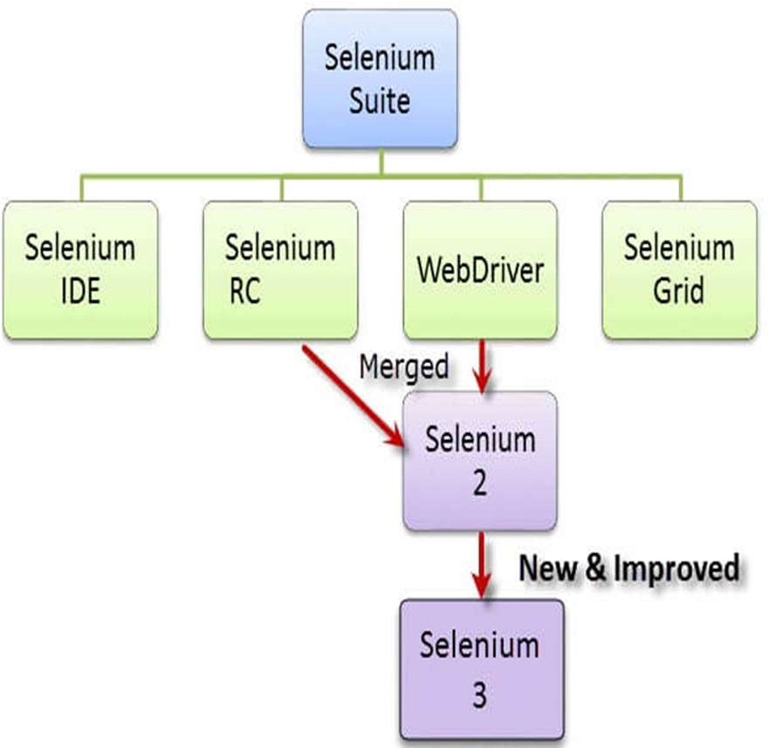
Selenium Suite
At the moment, Selenium RC and WebDriver are merged into a single framework to form Selenium 2

Slide 22
Selenium Integrated Development Environment
Selenium Integrated Development Environment (IDE) is the simplest framework in the Selenium suite and is the easiest one to learn.
It is a Firefox plugin that you can install as easily as you can with other plugins.
It should only be used as a prototyping tool (for UI design)

Slide 23
Selenium WebDriver
Selenium WebDriver is a web framework that permits you to execute cross-browser tests.
This tool is used for automating web-based application testing to verify that it performs expectedly.
Selenium WebDriver allows you to choose a programming language to create test scripts
The WebDriver proves itself to be better than both Selenium IDE and Selenium RC in many aspects.
It implements a more modern and stable approach in automating the browser's actions. WebDriver, unlike Selenium RC, does not rely on JavaScript for Automation.
It controls the browser by directly communicating with it.

Slide 24
Selenium Grid
Selenium Grid is a tool used together with Selenium RC to run parallel tests across different machines and different browsers all at the same time. Parallel execution means running multiple tests at once.
Features:
Enables simultaneous running of tests in multiple browsers and environments.
Saves time enormously.
Utilizes the hub-and-nodes concept. The hub acts as a central source of Selenium commands to each node connected to it.

Slide 25
How to Choose the Right Selenium Tool for Your Need?
TOOL | Why to choose?
Selenium | ▪ | To learn about concepts on automated testing and Selenium
IDE | ▪ | To create simple tests cases with little or no prior knowledge in programming.
 | ▪ | To test a web application against Firefox and Chrome only.
Selenium | ▪ | To run your test against different browsers (except HtmlUnit) on different
RC |  | operating systems.
 | ▪ | To deploy your tests across multiple environments using Selenium Grid.
 | ▪ | To test your application against a new browser that supports JavaScript.
 | ▪ | To test web applications with complex AJAX-based scenarios.
WebDriver | ▪ | To use a certain programming language in designing your test case.
 | ▪ | To test applications that are rich in AJAX-based functionalities.
 | ▪ | To create customized test results.
Selenium | ▪ | To run your Selenium RC scripts in multiple browsers and operating systems
Grid |  | simultaneously.
 | ▪ | To run a huge test suite, that needs to complete in the soonest time possible.
HtmlUnit is a GUI-less/headless web browser written in Java for Java programs
Notes:
AJAX stands for Asynchronous JavaScript And XML. In a nutshell, it is the use of the XMLHttpRequest object to communicate with servers. It can send and receive information in various formats, including JSON, XML, HTML, and text files

Slide 26
Why should I use Selenium?
Selenium advantages over similar tools
Open source, free to use, and free of charge.
Highly extensible
Can run tests across different browsers
Supports various operating systems
Supports mobile devices
Can execute tests while the browser is minimized
Can execute tests in parallel.

Slide 27
Shortcomings of Selenium Everything has limitations!!!
Can only test web applications
Has no built-in object repository
Automates at a slower rate because it does not have a native IDE and only third party IDE can be used for development
Data-driven testing is more cumbersome since you have to rely on the programming language's capabilities for setting values for your test data
Cannot access elements outside of the web application under test
No official user support is being offered.

Slide 28




Selendroid
Selendroid is a test automation framework which drives off the UI of Android Native and hybrid applications (apps) and the mobile web.
Selendroid is based on the Android instrumentation framework. Currently only the testing of one specific app is supported. Selendroid requires the following permission for your app:
<uses-permission android:name="android.**permission.INTERNET"/>

Slide 29
Selendroid
Selendroid can be used to test already built apps.
Android apps (apk file) must exist on the machine, where the selendroid-standalone server will be started.
The reason for this is that a customized selendroid- server for the app under test (AUT) will be created.
Both apps (selendroid-server and AUT) must be signed with the same certificate in order to install the apks on the device.

Slide 30
Features of Selendroid
No modification of app under test required in order to automate it
Testing the mobile web using built in Android driver webview app
Same concept for automating native or hybrid apps
UI elements can be found by different locator types
Gestures are supported: Advanced User Interactions API
Selendroid can interact with multiple Android devices (emulators or hardware devices) at the same time
Existing Emulators are started automatically
Selendroid supports hot plugging of hardware devices
Full integration as a node into Selenium Grid for scaling and parallel testing
Multiple Android target API support (10 to 19)
Built in Inspector (to inspect UI components) to simplify test case development.
Selendroid can be extended at runtime with your own extensions !

Slide 31
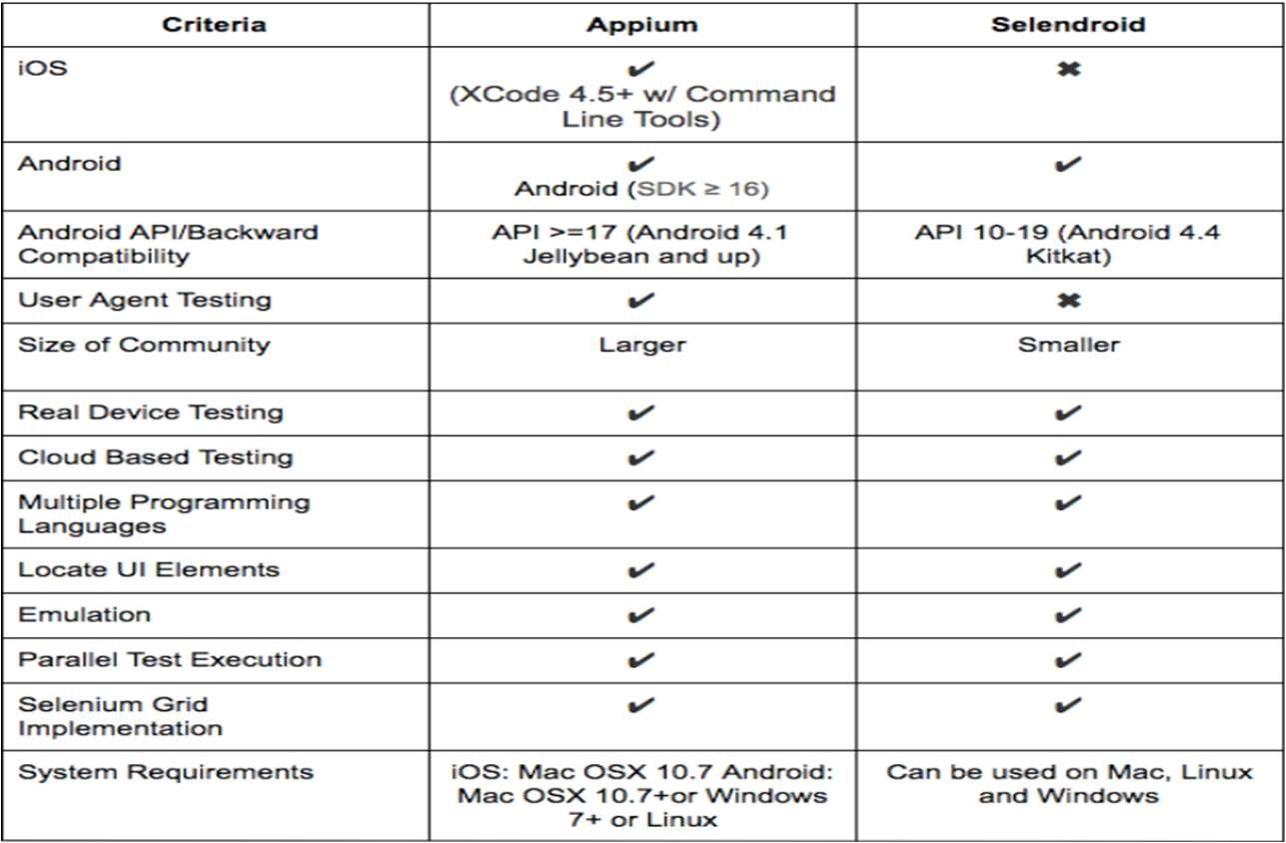
Why should I use Selendroid?

Slide 32
Why should I use Selendroid?
Selendroid is a good option if you’re thinking of developing only Android apps.
▪ Main selling point is its backward compatibility; it supports Android API 10 (Android 2.3.3) through API 19 (Android 4.4).
Also notable is that Selendroid contains an Inspector tool which can inspect UI elements of the app being tested. Although you can find UI elements in Appium as well, the advantage that Selendroid has over Appium is that Selendroid can find UI elements for older Android versions, too.
There are a few other features Selendroid has in its arsenal. During tests, devices can be plugged or unplugged without interrupting the test being run, also called “hot plugging.” This in turn is helped by Selendroid’s ability to interact with multiple Android devices at the same time, which includes emulators and hardware devices, saving you a lot of time in the process.

Slide 33

Shortcomings of Selendroid
For mobile browsers there are multiple challenges posed by Selendroid
Choosing the right Selenium library
Testing for emulators or devices
Handling unsupported device specific features
Selendroid requires to recompile applications to test them

Slide 34
Introduction To Automation Testing
Automation Testing means using an automation tool to execute the test case suite.
Test automation is the use of special software to control the execution of tests and the comparison of actual outcomes with predicted outcomes
A test automation framework is an integrated system that sets the rules of automation of a specific product
This system integrates the function libraries, test data sources, object details and various reusable module.
The framework provides the basis of test automation and simplifies the automation effort.
Tools are specifically designed to target some particular test environment, Tools serve as a driving agent for an automation process

Slide 35
Framework for Automation
A framework is set of automation guidelines which help in
Maintaining consistency of Testing
Improves test structuring
Minimum usage of code
Less Maintenance of code
Improve reusability
There are various types of frameworks
Data-driven testing (DDT) (for testing the login feature we can take ‘N’ number of usernames and passwords in an excel file and feed that data to the java file which contains the programming logic of automating the login functionality.)
Modularity-driven testing (small, independent modules of automation scripts are developed)

Slide 36
Framework for Automation Cont.
Keyword-driven testing (keywords that are developed represent an action., for testing the login feature we will have multiple steps like launching the browser, setting the username and password and closing the browser in the form of keywords or actions in the excel file.)
Hybrid testing (like combination of Top-down/Bottom-up, Data-driven/Keyword-driven)
Model-based testing (Models can be used to represent the desired behavior of a system under test (SUT), or to represent testing strategies and a test environment)
Models can can cover any level of requirements, from business logic to user story, and can be connected to each other. Then you can automatically generate test cases based on the models once they are done creating it.
Behavior-driven development (BDD)
▪ SpecFlow and Cucumber
BDD is designed to test an application's behavior from the end user's standpoint, whereas TDD (Test driven development) is focused on testing smaller pieces of functionality in isolation

Slide 37
UI AUTOMATOR
UI Automator is a UI testing framework suitable for cross-app functional UI testing across system and installed apps basically used for mobile testing
UI Automator testing framework provides a set of APIs to build UI tests that perform interactions on user apps and system apps.
UI Automator APIs allows to perform operations such as opening the Settings menu or the app launcher in a test device.
UI Automator testing framework is well-suited for writing black box- style automated tests, where the test code does not rely on internal implementation details of the target app.

Slide 38
UI Automator – Key Features
The key features of the UI Automator testing framework include the following:
A viewer to inspect layout hierarchy.
An API to retrieve state information and perform operations on the target device.
APIs that support cross-app UI testing. For more information, see UIAutomator APIs.

Slide 39
UI Automation Viewer
The UI automator viewer tool provides a convenient GUI to scan and analyze the UI components currently displayed on an Android device.
You can use this tool to inspect the layout hierarchy and view the properties of UI components that are visible on the foreground of the device.
This information lets you create more fine-grained tests using UI Automator
The ui automator viewer tool is located in the <android- sdk>/tools/bin directory

Slide 40
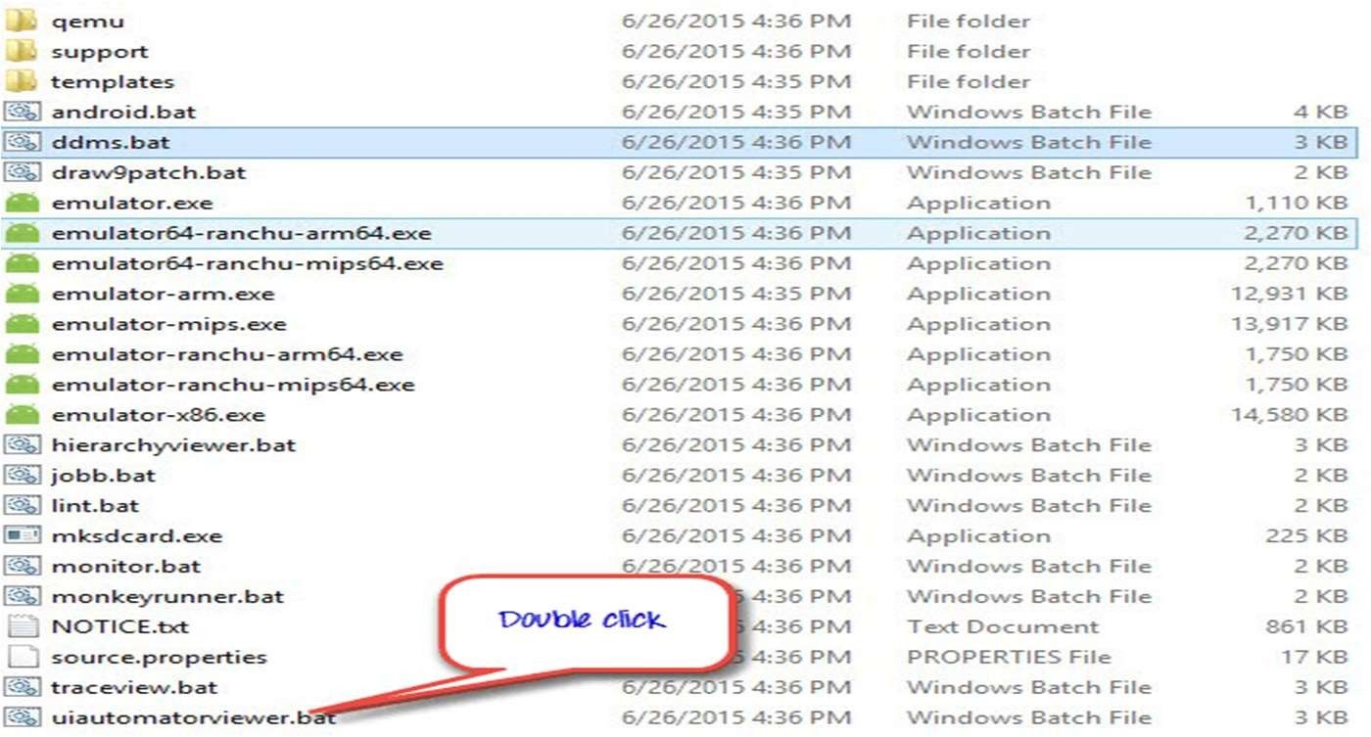
Where to find UI Automation Viewer?
ui automatorviewer tool is located in the
<android-sdk>/tools/bin/directory.

Slide 41
UI Automator Viewer Framework
UI Automator testing framework provides a UIdevice class to access and perform operations on the device on which the target app is running.
One can call its methods to access device properties such as current orientation or display size.
UIDevice
public class UiDevice extends Object
java.lang.Object
androidx .test.uiautomator.UiDevice
▪ UiDevice provides access to state information about the device. You can also use this class to simulate user actions on the device

Slide 42
UI Automator Viewer Framework
UI Device Can also perform actions like:
Change the device rotation.
Press a hardware key, such as "volume up".
Press the Back, Home, or Menu buttons.
Open the notification shade.
Take a screenshot of the current window.
For example, to simulate a Home button press, call the UiDevice.pressHome() method.

Slide 43
UI Automator APIs
UI Automator APIs allow you to write robust tests without needing to know about the implementation details of the app that you are targeting.
UiCollection:
Enumerates a container's UI elements for the purpose of counting, or targeting sub-elements by their visible text or content-description property
Provides support for searching for items in a scrollable UI container.
Represents a query for one or more target UI elements on a device.
Allows to set key parameters for running UI Automator tests.
UiScrollable:
UiSelector:
Configurator:

Slide 44
Test UI for Multiple Apps
A user interface (UI) test that involves user interactions across multiple apps lets you verify that your app behaves correctly when the user flow crosses into other apps or into the system UI.
Early failure detection -in the development cycle.
Safer code refactoring - letting you optimize code without worrying about regressions

Slide 45
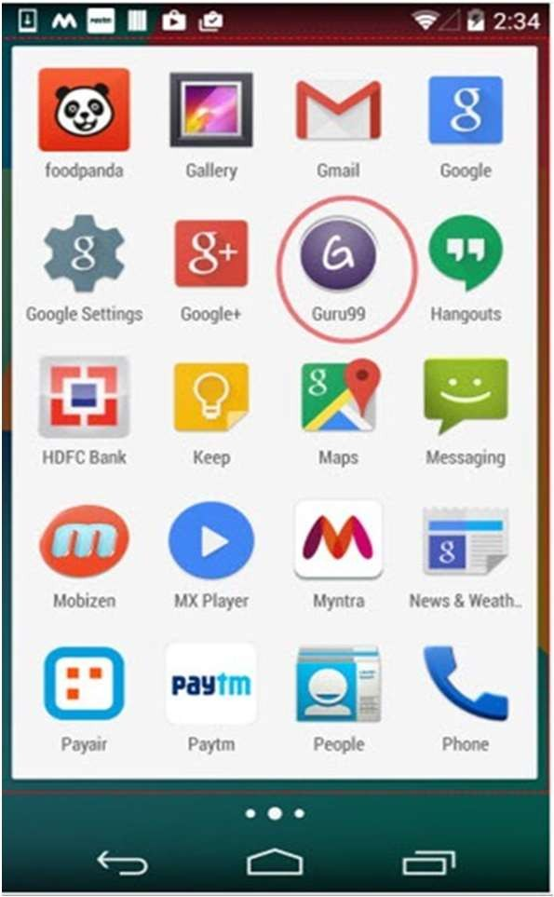
How to use UI Automator?
'Device screenshot' button to refresh the "Uiautomatorviewer" and to load the guru99 application GUI on "Uiautomatorviewer"
https://www.youtube.com/watch?v=eKL5V3A2rj8

Slide 46
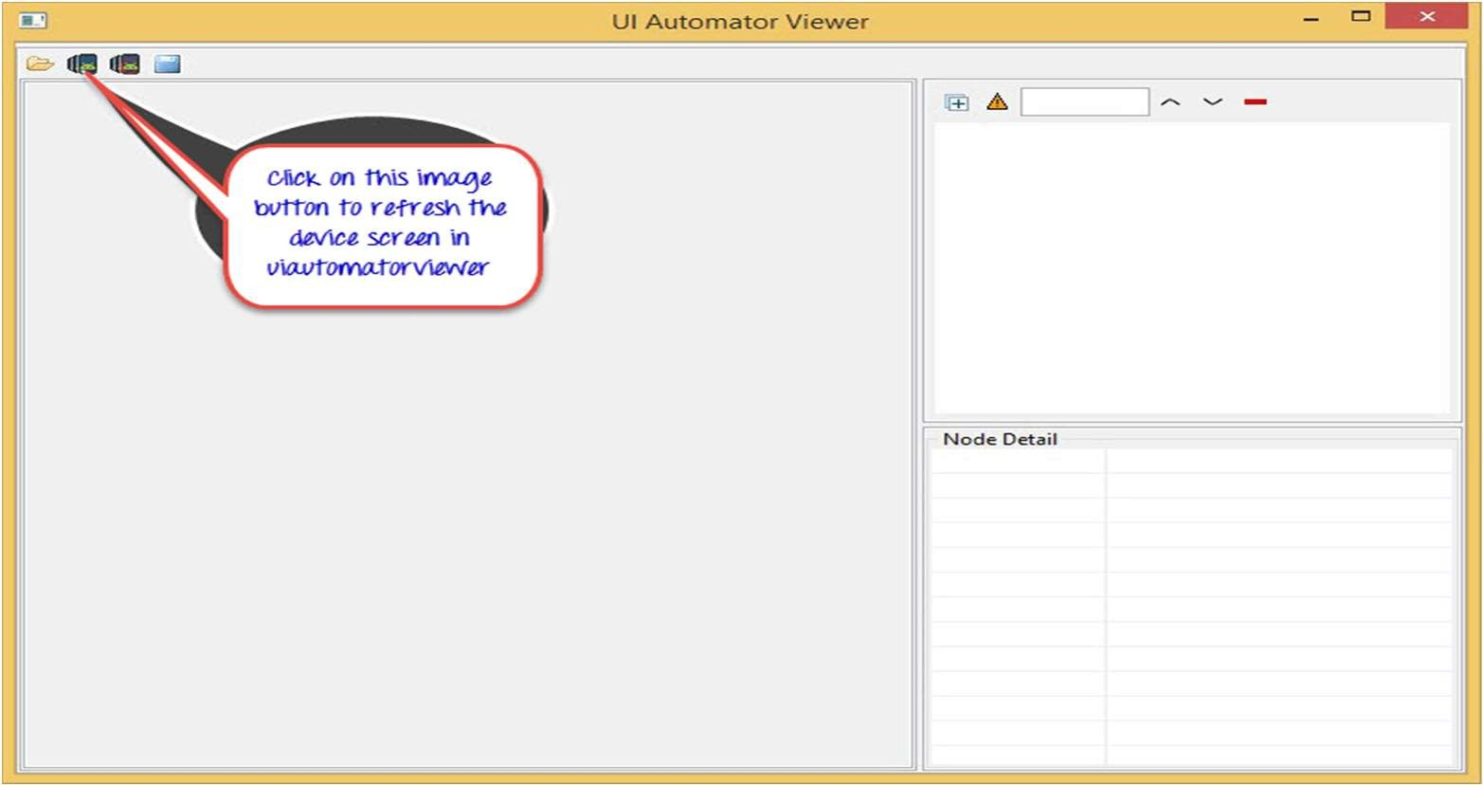
How to use UI Automator?
After refresh is completed, a screenshot of Guru99 application opens

Slide 47
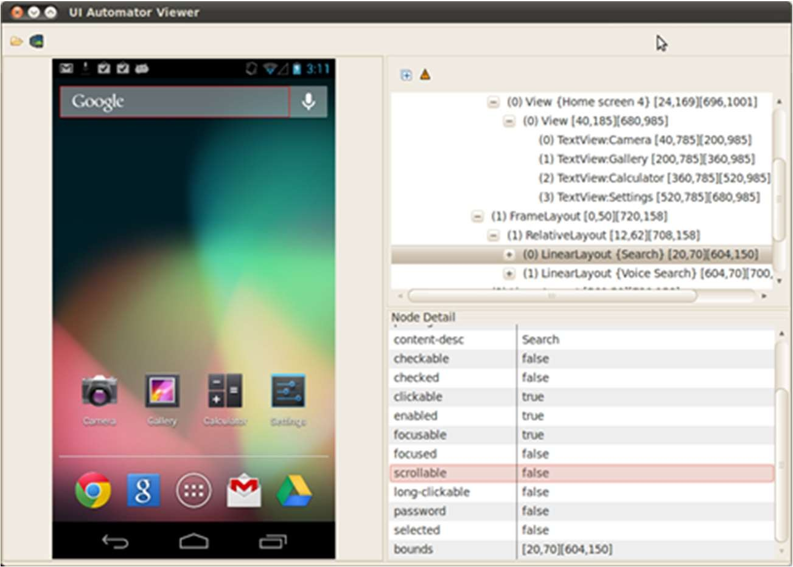
How to use UI Automator?

Slide 48
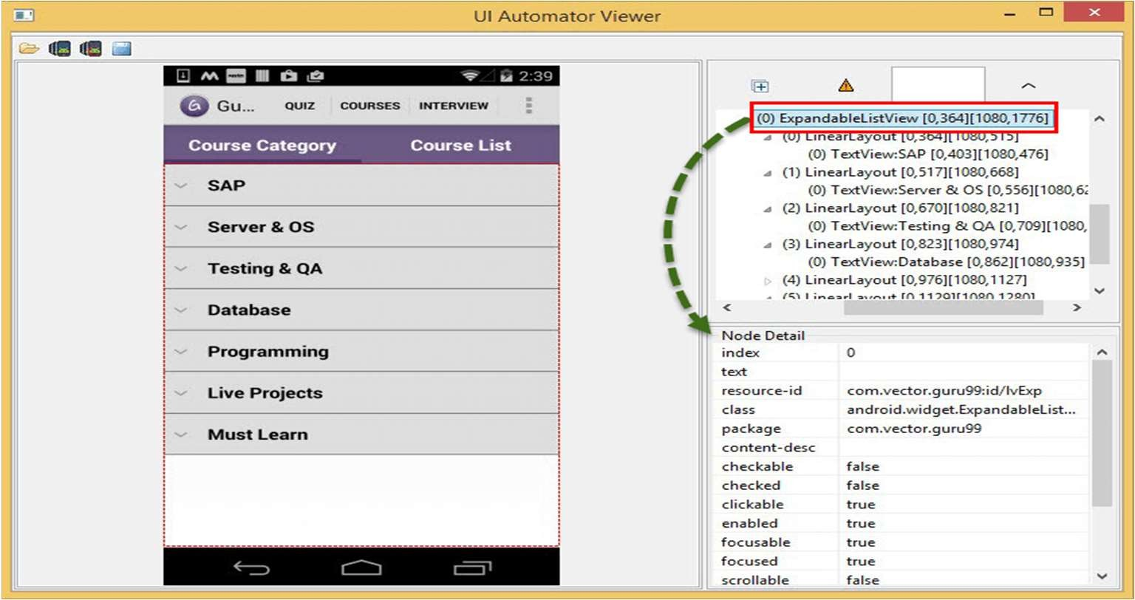
How to use UI Automator?
As you see in the above image, on the right side of the window there are 2 panels.

Slide 49
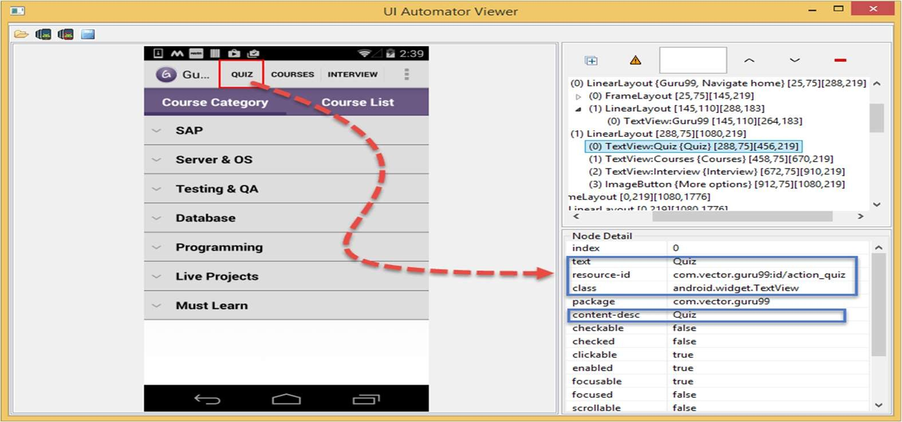
How to use UI Automator?
Upper panel contains node hierarchy the way the UI components are arranged and contained, clicking on each node gives properties of UI elements in the lower panel Select 'Quiz' button in the above image to view different properties (text,resource-id...)

Slide 50
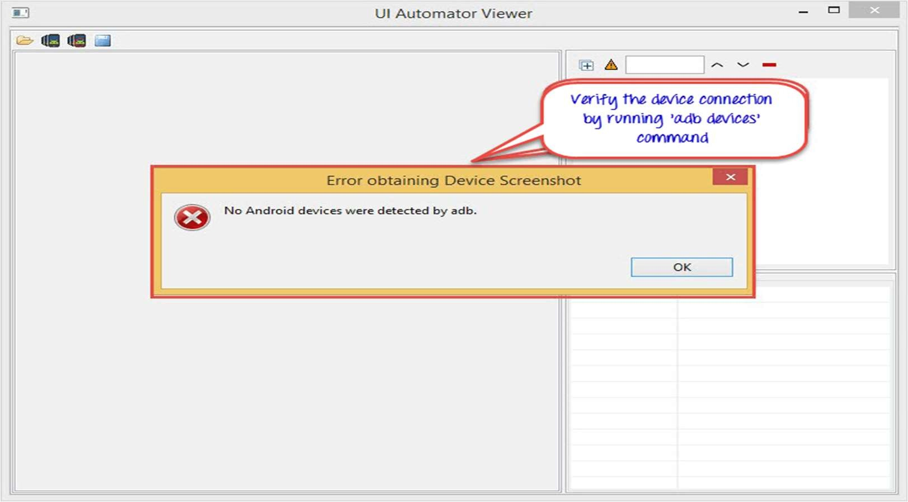
How to use UI Automator?

Slide 51
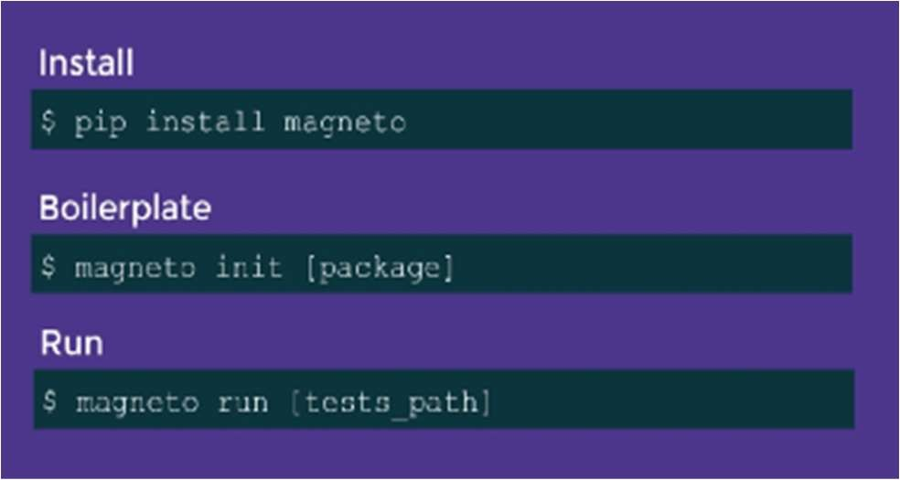
Introduction To Magneto
Magneto is an open source test automation framework that allows to write smart and powerful tests for Android apps.
Magneto was built by Automation Engineers for Automation Engineers out of necessity for a mobile centric test automation framework that’s easy to setup, run and utilize.
Magneto is written in Python for Android devices.
It utilizes the uiautomator tool via a Python wrapper and pytest as a test framework.
Pytest is a testing framework based on python. It is mainly used to write API test cases.
Magneto can be triggered from CLI, IDE and CI.
Notes:
Pip - preferred installer program - a standard package manager used to install and maintain packages for Python.

Slide 52
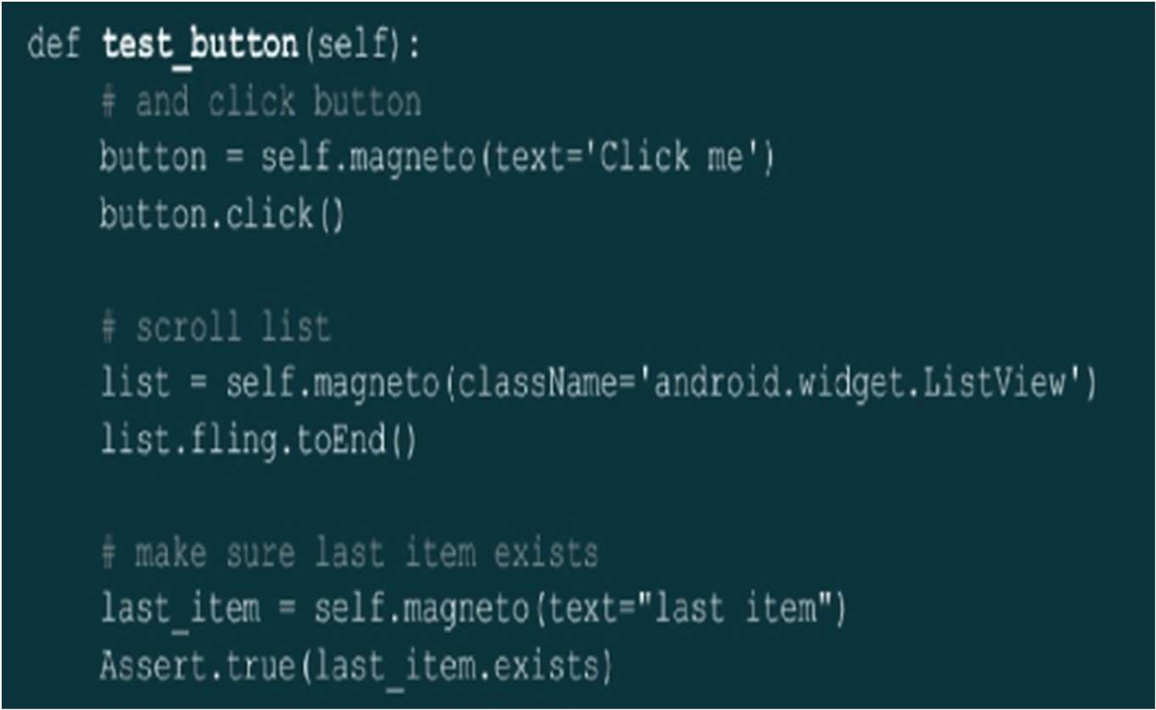
Magneto

Slide 53

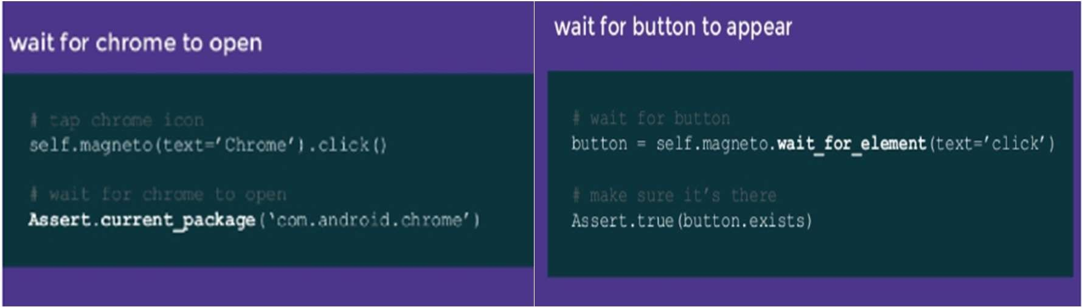
Magneto

Slide 54
Common Usages
Tag
Magneto allows attaching tags to test cases and tests alike, using @pytest.mark.TAG_NAME:
@pytest.mark.cardsclass CardsTestCase(BaseTestCase) :""" @pytest.mark.toggle
def test_cards_toggle(self):
Now I can choose to run only CardsTestCase using -k cards:
$ magneto run ui_tests/ -k cards

Slide 55
Skip & Blockers
Skip
Magneto allows conditional skipping for test cases and tests, using @pytest.mark.skipif(CONDITION,
reason=REASON):
@pytest.mark.skipif(settings.param == False, reason='Skipped cause param is False') class Example
TestCase(BaseTestCase):
""" Tests example functionality """
def test_example_1(self):
...
----------------------------------------------------------------------------------------------------------------------------
Blockers
Some tests can be defined as blockers so that if they fail, all the rest would be skipped. Example:
class Example TestCase(BaseTestCase):
""" Tests example functionality """
@pytest.mark.blocker
def test_example_1(self):
---------------------------------------------------------------------------------------------------------------------------
https://magneto.readthedocs.io/en/latest/index.html
https://magneto.readthedocs.io/en/latest/common_usage.html

Slide 56
Test Results
Test results are available via Magneto logs:
ui_tests/ftu_test.py .s ui_tests/cards_test.py F
ui_tests/discovery_test.py .ui_tests/folders_test.py ..s..
ui_tests/homescreen_test.py .
ui_tests/magneto_test.py .... ui_tests/search_test.py .F....
In the log above, each line represents a test case and its tests results.
. = passed
s = skipped
F = failed

Slide 57
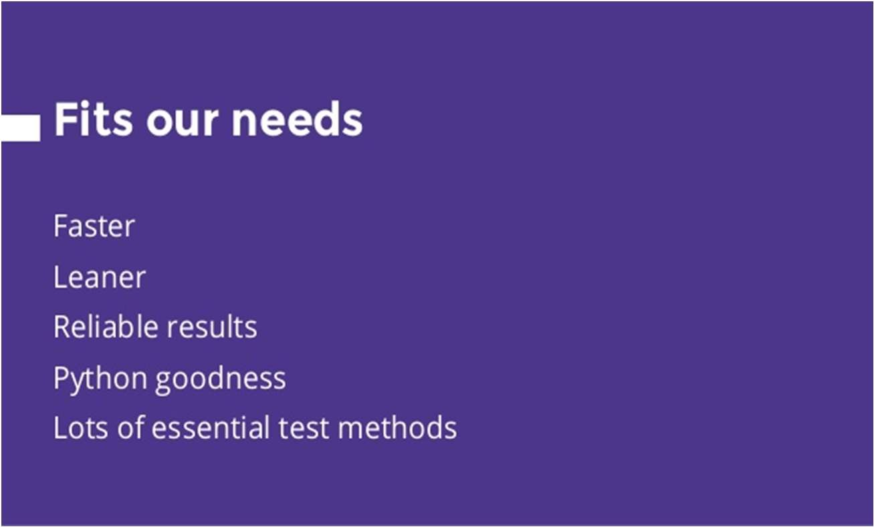
Magneto Benefits
Magneto Demo: https://www.youtube.com/watch?v=wDPfbhAaqZI

Slide 58
Defect Management Tools
Defect management tools are an important part of the software development process, and something software testers heavily rely on.
Need a place to track and store all the defects logged during various testing phases and cycles
Many defect management solutions/tools are available today.
Choosing the right defect management tool is crucial to the success of your team.
Spreadsheet could be used as well
Consider basic features like ticket statuses, email notifications, and the overall usability/experience
Is it scalable, customizable, work with source control tool?
Reporting capabilities
https://blog.testlodge.com/defect-management-tools-list/
https://www.youtube.com/watch?v=q6-QIcNCxRo

Slide 59
Insides of Mobile Testing
Mobile application testing is a process by which application software developed for handheld mobile devices is tested for its functionality, usability and consistency.
Mobile application testing can be an automated or manual type of testing.
Automation tests on such mobile applications are done with UI Automaton and Magento frameworks.
Mobile application testing accordingly focuses on field testing, user focus and looking at areas where hardware and software need to be tested in unison.

Slide 60
Key Challenges for Mobile Application Testing
Must be Downloadable
Diversity in Mobile Platforms/OSes
Device Availability
Mobile network operators
Scripting
Test Method
Compatibility
Should be able to Pick up the Phone
Variety of Mobile Devices

Slide 61

THANK YOU
Prof. Venkatesh Prasad
venkateshprasad@pes.edu
Department of Computer Science

